Slide 1
EPQ preparation
Please complete before your first lesson.
Welcome to EPQ. You are going to love this course. Have a read about it on the AQA website: https://www.aqa.org.uk/subjects/projects/level-three/projects-7993/specification
Notes:
Suzie

Slide 2
TASK ONE - read the following slides to ensure you understand what the qualification entails. You can listen to the voiceovers too.

Slide 3


What is an EPQ?
The Extended Project Qualification (EPQ) is a Level 3 course which is taken alongside A-Levels. You’ll be required to complete a project based on a research project of your choice.
It can be related to a subject outside of your current areas of study.
The project can be in the form of an essay or report, an artefact, musical composition or dramatic project (backed up with paperwork).

Slide 4

How can an EPQ help your
university application?
The EPQ is worth a maximum of 28 UCAS points, which is equivalent to half an A Level. University applicants who take the EPQ often are made two offers: the standard offer for their programme of choice; and an alternative offer which may be one grade lower plus a good grade in the EPQ.
Please note this often excludes Medicine and Dentistry programmes.
For example, where a standard offer maybe AAA the alternative offer would be AAB plus A in the EPQ.

Slide 5
Choosing an EPQ topic
You can study any topic you wish – but it’s a good idea to choose something related to the subject that you intend to study at university.
An EPQ gives you the opportunity to expand learning in an area that really interests you, so don’t be afraid to go beyond your A-level syllabus.
Do try to be specific, as it will help you to focus your research and develop a great project.
Whatever you choose, remember that you must agree your title with your EPQ supervisor.

Slide 6

How is an EPQ completed?
All projects must include a written report of at least 1000 words although a written dissertation normally has a word count of 4000-5000 words.
However, the outcome of the EPQ can be almost anything. For example: a dissertation, an artefact or model, a performance, a short film, a website or piece of software, a design or blueprints.
Once complete, you must also give a short presentation about your project.

Slide 7
How is an EPQ assessed?
Assessment is undertaken by your supervisor and externally moderated by the exam board. Grades are awarded in the range A*-E.
You will be assessed in the following areas:
  Management
  Use of resources
  Development and realisation
  Objectives and achievement

Slide 8

Top tips for EPQs
Set yourself deadlines for each area of your project to help you keep on track – and try to stick to these as much as possible.
Look at your resources – what time do you have available to work on the project? It may be worth scheduling this into a timetable.
Choose a topic which really interests you and you want to find out more about.
Make sure the research question you choose is manageable – and make sure you have enough time available and the skills required to complete the question.
Think about your future to keep motivated – the EPQ is worth up to 28 UCAS points, so by completing it, you could be a step nearer to securing your place at university.
Refer to the assessment criteria to make sure that your project will fulfil the requirements.
Don’t forget to ask for help when needed – your supervisor is there to support you through the project.

Slide 9
The Assessment Objectives

Slide 10
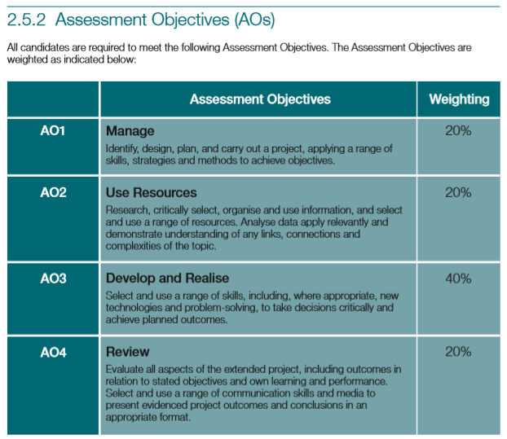

Slide 11
The Production Log (Before you read the next few slides, read through the production log you have been sent).
You are not expected to complete the production log but it is important you understand what you will be doing throughout the year. The production log is the MOST IMPORTANT document you will complete on your EPQ journey.

Slide 12
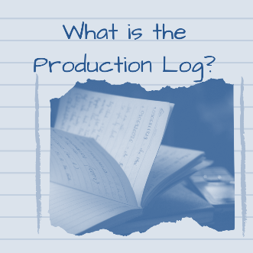

The Production Log
Some people make the mistake of thinking the EPQ is all about the PRODUCT you hand in at the end i.e. the report or the artefact – but this is wrong.
The journey you take with your project is EQUALLY important – that is how you have managed the production and the changes you have made along the way.
This is all recorded in the Production Log that is one of the THREE items you will hand in at the end of your EPQ:
PRODUCTION LOG
PRODUCT
RECORD OF PRESENTATION
The log is part of the 15 page AQA document that comes with this presentation and includes the candidate (that is YOU) record form, production log and assessment record and has parts for you, your project supervisor and the centre coordinator to fill in.

Slide 13
The Production Log
In essence the Production Log demonstrates how you have managed your project from the beginning to the end.
There are additional management tools you can submit along with this log which will be covered nearer the time. These are a diary of progress; Gantt Chart and/or a PERT analysis.
These may help you to organise your work from beginning to end.

Slide 14
The Production Log – an Overview
Have a look at each section of the Production Log alongside this presentation.
The RECORD OF INITIAL PLANNING records your aims and your objectives (we look at this in the Starting your Project presentation).
It is important to remember that this can also provide evidence of management (AO1). Tip here is to pay attention to the detail and many students waste useful space by writing quite brief proposals.

Slide 15
The Production Log – an Overview
PROJECT PROPOSALS PARTS A, B and C are completed by you, your supervisor and the centre coordinator.

Slide 16
The Production Log – an Overview
Once you have got approval from your supervisor for your project, the next steps are recorded in your PLANNING REVIEW.
Here you make for extensive investigations by reading the sources you have identified and then discussing your plans with your supervisor. You must record their advice in this review. This includes:
Outline the next steps in your planned research/initial development
Your supervisor’s main comments and advice
Changes, clarifications or additions you have made as a result of your discussion and comments from the centre coordinator

Slide 17
The Production Log – an Overview
The MID-PROJECT REVIEW is where you outline your successes and failures and any changes you have made since you started your project.
If you are using a supplementary management tool (such as a diary I mentioned previously) – it is important you mention here in your log.
Are you on track?
Did your literature review take longer than planned?
Are you struggling to find enough information?
This is all about that journey so far and it is important you discuss this with you supervisor and record it here.

Slide 18
The Production Log – an Overview
The END OF PROJECT REVIEW takes place again after you have met with your supervisor.
You need here to give an honest account of your successes and failures and any changes you have made since your MID PROJECT REVIEW.
It is important here that you justify and changes or decisions that you have made. Answering the ‘why’ question is important here.

Slide 19
The Production Log – an Overview
The REVIEWS follow a simple format:
Outline the successes, failures, additions and or changes you have made as you followed your plan at the start of your project
Outline your planned steps to complete your project
Your supervisor’s main comments and advice at this stage
Changes, clarifications or additions you have made as a result of your discussions with your supervisor at this stage.

Slide 20
The Production Log – an Overview
The SUMMARY is completed after you have finished your report.
It should be a brief explanation (about 150 words) of your PRODUCT, that is, what you have produced.

Slide 21
The Production Log – an Overview
The PRESENTATION RECORD should document your planning and give an account of YOUR EPQ journey.
It should not just reference the product itself.
Remember to include evidence in your presentation, such as copies of any PowerPoint slides that you used.
If you have filmed your presentation – upload it to YouTube for example and include a link here.

Slide 22
The Production Log – an Overview
Finally – we come to the REFLECTION which should be written after your presentation.
This should summarise the main learning points such as any new knowledge that you have gained and found valuable such as learning how to carry out a literature review, which will stand you in great stead from university.
Make sure you also refer to your failures here as well as your successes as these are all part of your learning curve.
You may also want to draw upon what you would do differently if you were to complete the project again or where you could take your project further next time.

Slide 23
TASK TWO - start thinking about your topic

Slide 24

Extended Project:
Make a start
Choosing a topic & asking questions

Slide 25
Interests - What are you interested in?
…really interests you
Future study or career – Do you want to research something that may be useful later?
CHOOSING A TOPIC
Development of your understanding …something you know about, but not everything
Timescale - How long have you got?
…you can realistically research

Slide 26
Extended essay
Action research report
TYPE OF ASSIGNMENT
Artefact Physical outcome – model, book, etc
Artefact Event
Artefact Performance

Slide 27
CONSIDER THE FOLLOWING: TOO BIG, TOO SMALL OR ACHIEVABLE?
How has the UK responded to COVID-19?
OR
Did the UK government's response to COVID-19 adequately protect care home residents?

Slide 28
AIMS AND OBJECTIVES – EXAMPLE
Question:
Did the UK government's response to COVID-19 adequately protect care home residents?
Aims (Broad statements of desired outcomes):
Review the guidance and implementation of measures taken to protect care home residents. Assess the impact of these measures in relation to infection rates.
Objectives (steps you will take to achieve your aims):
Consider the guidance provided to care home managers. Consider whether this guidance was implemented appropriately. Review the available data (and assess its validity) and literature about infection rates in care homes relative to the timeframe of the guidance.

Slide 29
Activity 1
Consider the following
Hobbies
Career
Further Study
Subjects I really like
Something that makes me curious
Pick three ideas. For each complete a mindmap putting your thoughts down on paper. Please bring these to your first taught session. (See things to consider on the next slide).

Slide 30
Activity 1
Consider the following
Does your topic directly overlap with one of your A Levels/BTECs? (It is not allowed to).
Is your topic small enough that you can go into detail but big enough that you have something to write about?
If you are writing an essay, will you be able to select a research question within your topic? (You can’t just research a topic, you need to answer a question).
If you are creating an artifact, will you be able to obtain the skills and materials (if relevant) to do so?

Slide 31

Activity 1 - conclusion
Look through your answers to Activity 1
Look for possible links, overlaps or commonalities between your ideas
Jot down your thoughts about possible connections
You should end up with a web of ideas and connections that may enable you to come up with an area to investigate

Slide 32

Activity 2
Exploring Question Words
Before deciding on your research question you need to consider the different types of question you can ask
Before looking at the action words on the next slide and…
Identify which words would be most or least helpful in forming your question.
As you go along, consider why some will be more or less appropriate

Slide 33
Action words for Project Titles/Questions
Account for | Analyse | Assess | Comment | Compare | Contrast
Consider | Criticise | Define | Demonstrate | Describe | Determine
Discuss | Do / does | Evaluate | Examine | Explain | Find out
Illustrate | Investigate | Justify | Measure | Prove | Respond to
Record | Review | Should… | Summarise | To what extent… | What
When | Who | Why
Please bring a list of relevant action words/question words to your first taught session.

Slide 34
We look forward to seeing you soon.
Remember, before your first taught session you must have:
Read this presentation in detail
Looked through the production log
Made your mindmaps as directed in task one
Reflected on a list of action words/question words you could use
Please bring tasks 3 and 4 to the first taught session with you.

